Slide 1
Elasticity of Demand
HS201

Slide 2
Introduction
Demand can be classified as
Elastic
Inelastic or
Unitary
Examples
Inelastic demand :toilet paper or salt .
Elastic goods and services : furniture, motor vehicles, instrument engineering products, professional services, and transportation services.
Elasticity of demand is an important variation on the concept of demand.

Slide 3
Price elasticity of demand
the price elasticity of demand (PED) is an elasticity that measures the nature and degree of the relationship between changes in quantity demanded of a good and changes in its price.
PED = (% Change in Quantity Demanded)/(% Change in Price )

Slide 4
PED……
For most goods this ratio is negative, but in practice the elasticity is represented as a positive number and the minus sign is understood.
For example, if for some good when the price decreases by 10%, the quantity demanded increases by 20%, the PED for that good will be 2.

Slide 5
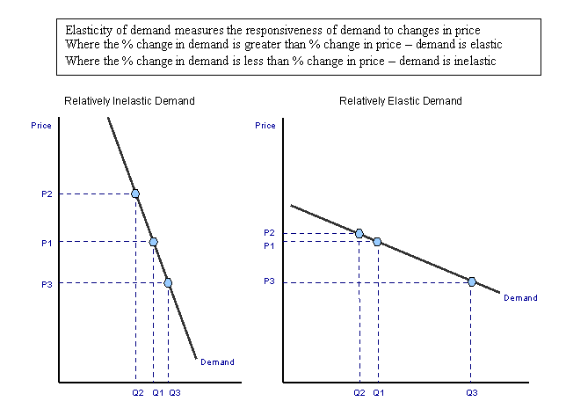
Demand curves with different price elasticity of demand

Slide 6
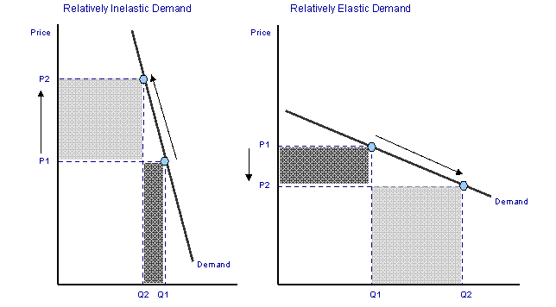
Elasticity of demand and total revenue for a producer

Slide 7
Implication of PED for Businesses and Government
PED is crucial for businesses because it has an impact on total revenue of the firm.
PED is important for the government in imposing indirect taxes (IT) because the imposition of taxes increase the prices.
Because IT affects the supply of products and if they are elastic the consumers will reduce their purchases more the price increases due to the tax imposition.
and there fore less tax will be paid if the PED is inelastic.

Slide 8
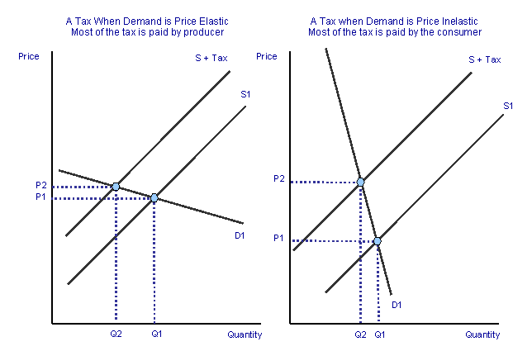
Elasticity of demand and indirect taxation

Slide 9
How Do We Interpret the PED?
PED is used to see how sensitive the demand for a good is to a price change.
The higher the price elasticity, the more sensitive consumers are to price changes.
A very high price elasticity suggests that when the price of a good goes up, consumers will buy a great deal less of it and when the price of that good goes down, consumers will buy a great deal more.
A very low price elasticity implies just the opposite, that changes in price have little influence on demand.

Slide 10
Income elasticity of demand
Income elasticity of demand (IED) measures the relationship between a change in quantity demanded and a change in income.
The basic formula for calculating the income elasticity is:
Percentage change in quantity demanded of good / percentage change in real consumers' income

Slide 11
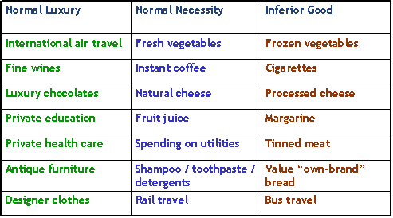
(IED) with different goods

Slide 12
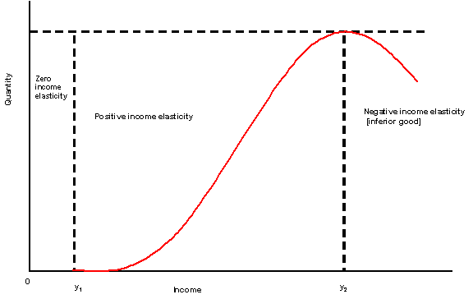
Graph for IED

Slide 13
Cross-Price Elasticity of Demand
The Cross-Price Elasticity of Demand measures the rate of response of quantity demanded of one good, due to a price change of another good.
If two goods are substitutes, we should expect to see consumers purchase more of one good when the price of its substitute increases.
Similarly if the two goods are complements, we should see a price rise in one good cause the demand for both goods to fall.
The common formula for the Cross-Price Elasticity of Demand (CPEoD) is
CPEoD = (% Change in Quantity Demand for Good X)/(% Change in Price for Good Y)

